Slide 1


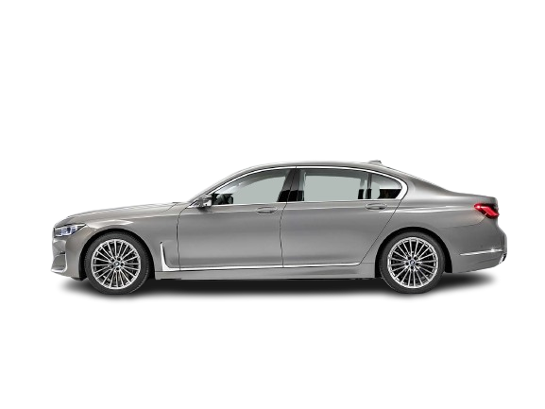
CONTROL THEORY FOR ADAS

Slide 2


# TYPES OF CONTROLLER
# PID CONTROLLER
# MPC CONTROLLER

Slide 3
# MATHEMATICAL MODEL
# FIRST PRICIPLES
# DIFFERENTIAL EQUATION
# SYSTEM IDENTIFICATION
# TRANSFER FUNCTION
# STATE SPACE MODEL
# AI CONTROL STRATEGY
GENETIC, REINFORCEMENT, NEURAL NETWORK,
FUZZY LOGIC

Slide 4
# MATHEMATICAL MODEL
# HEAT TRANSFER FORMULA CONDUCTION
Q = m*c*(Tout- Tin)
# simplified mathematical model CONVECTION
Q= UA(Tout​−Tambient​)
# RADIATION (NEGLIGIBLE)

Slide 5
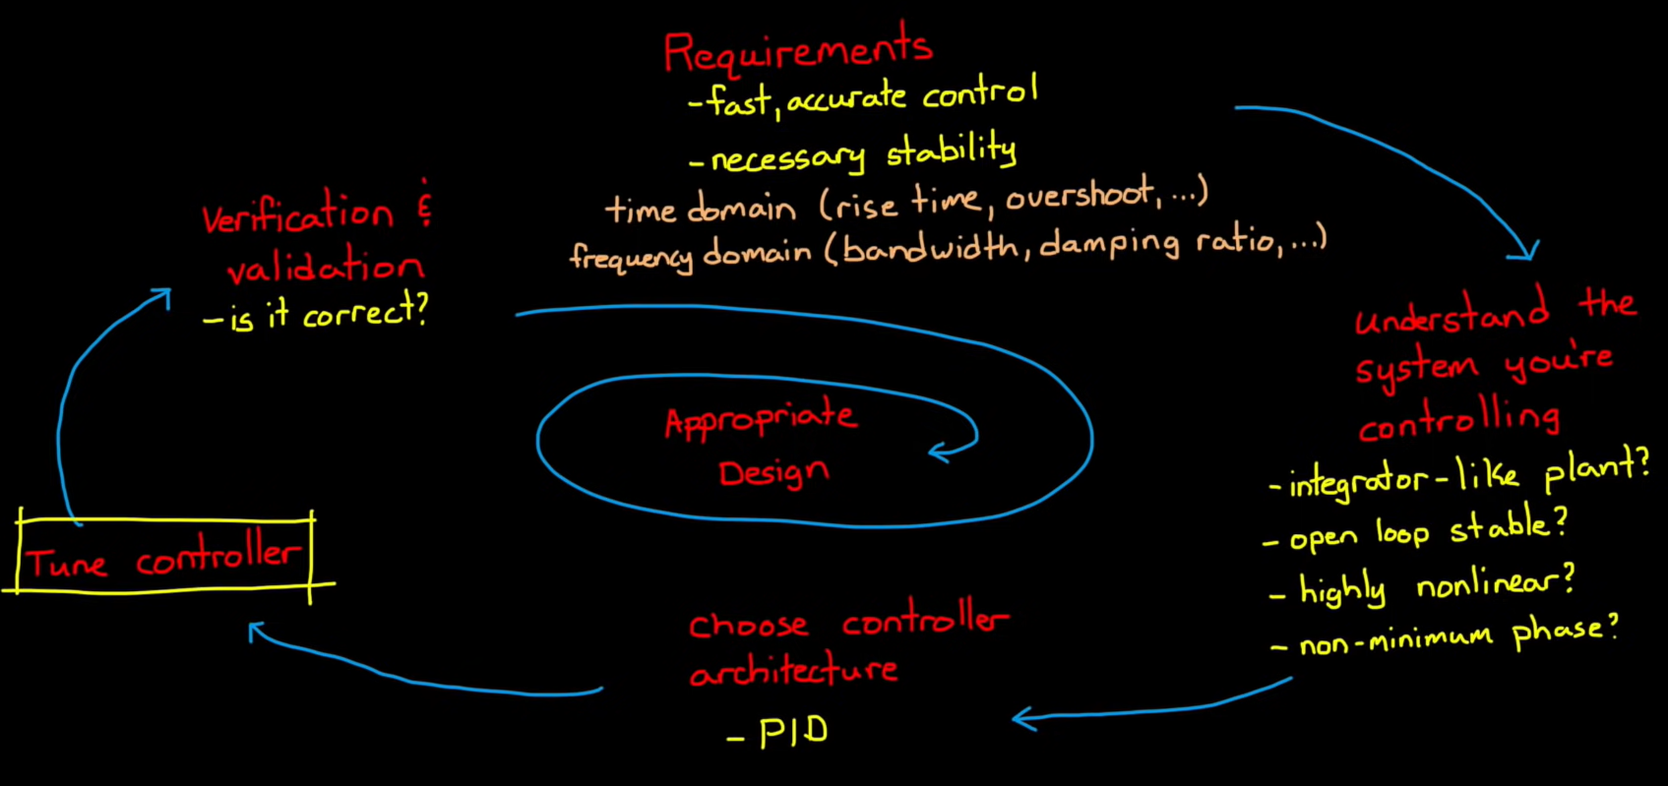
# CONTROL SYSTEM DESIGN

Slide 6
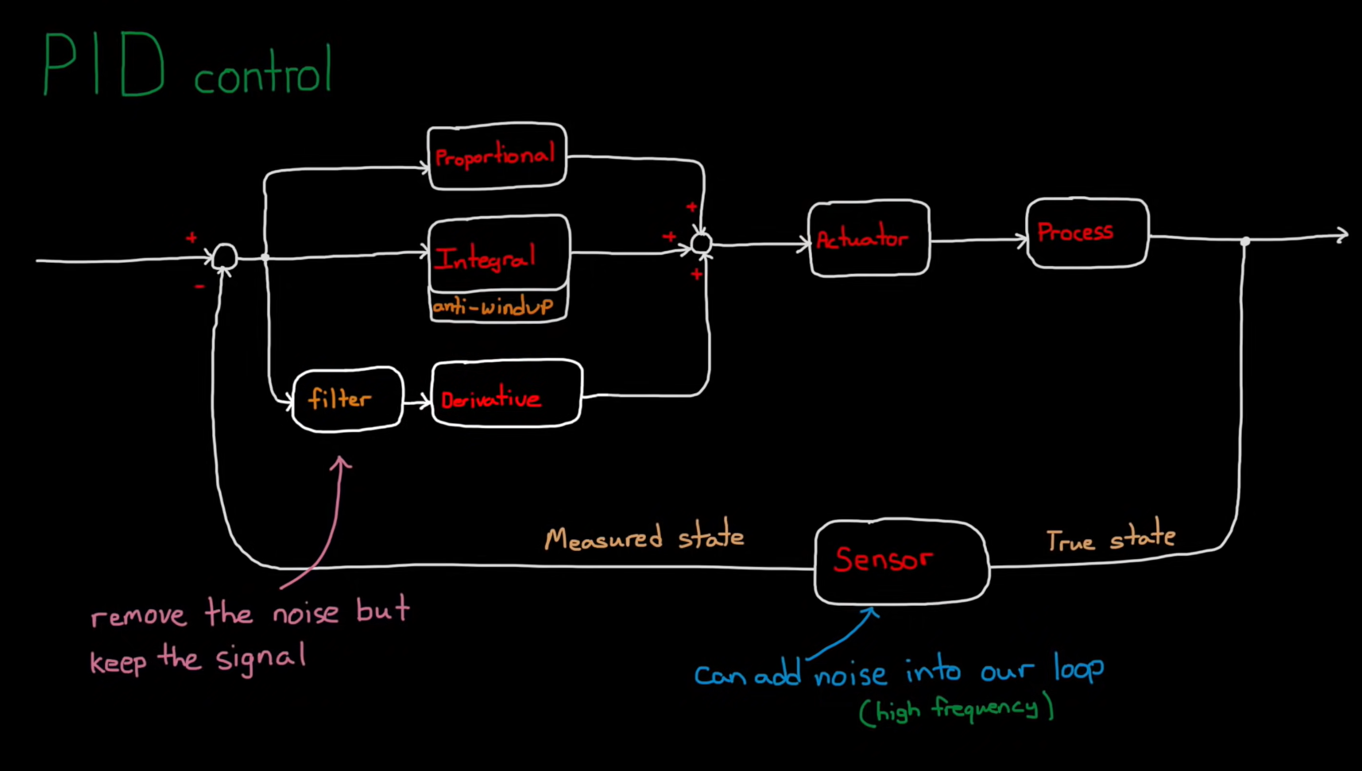
# PID CONTROL BLOCK DIAGRAM

Slide 7
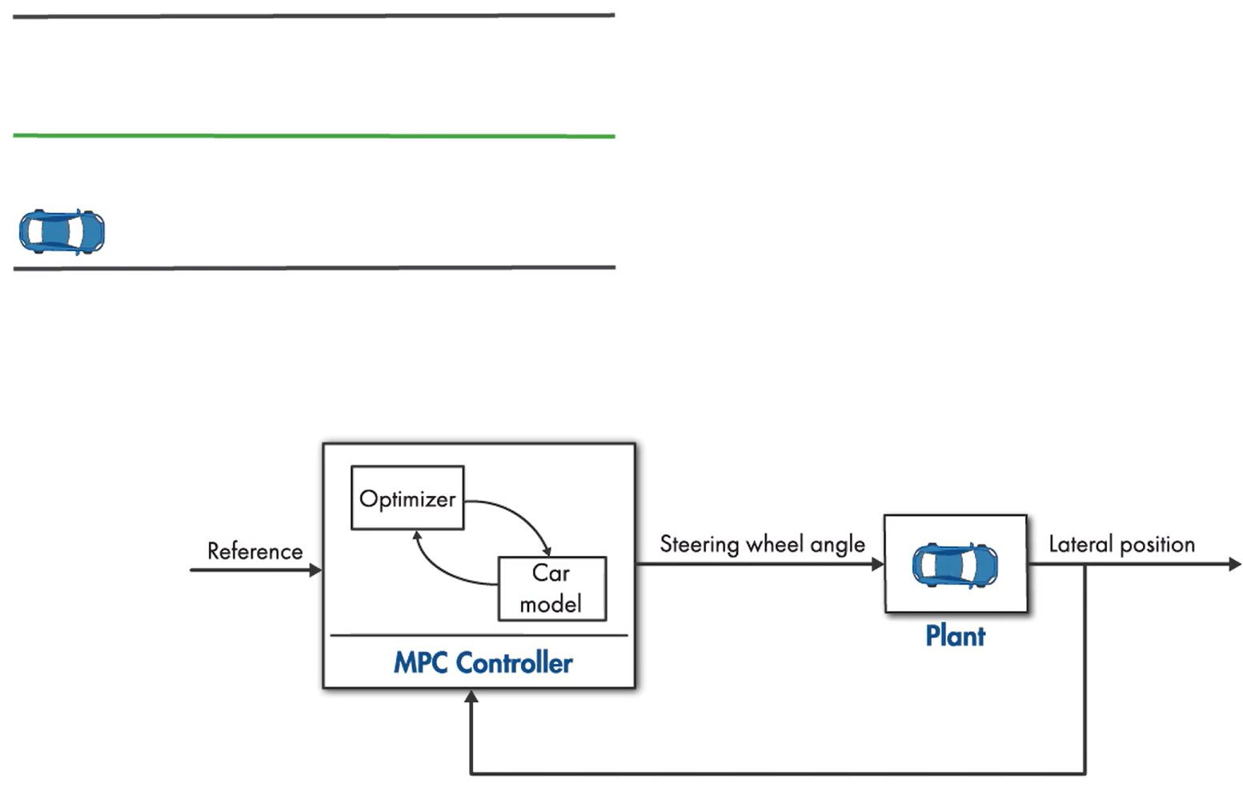
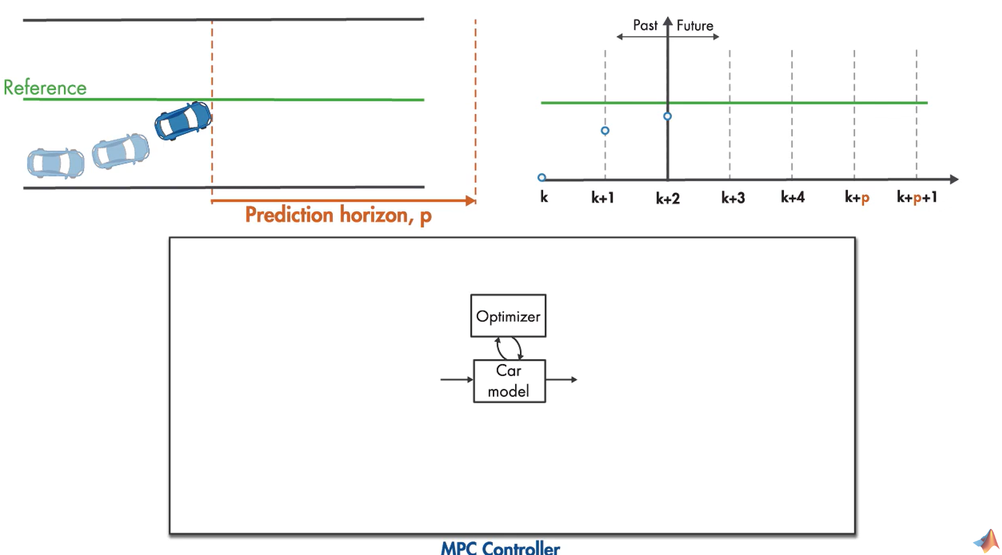
# MPC CONTROLEER
7

Slide 8
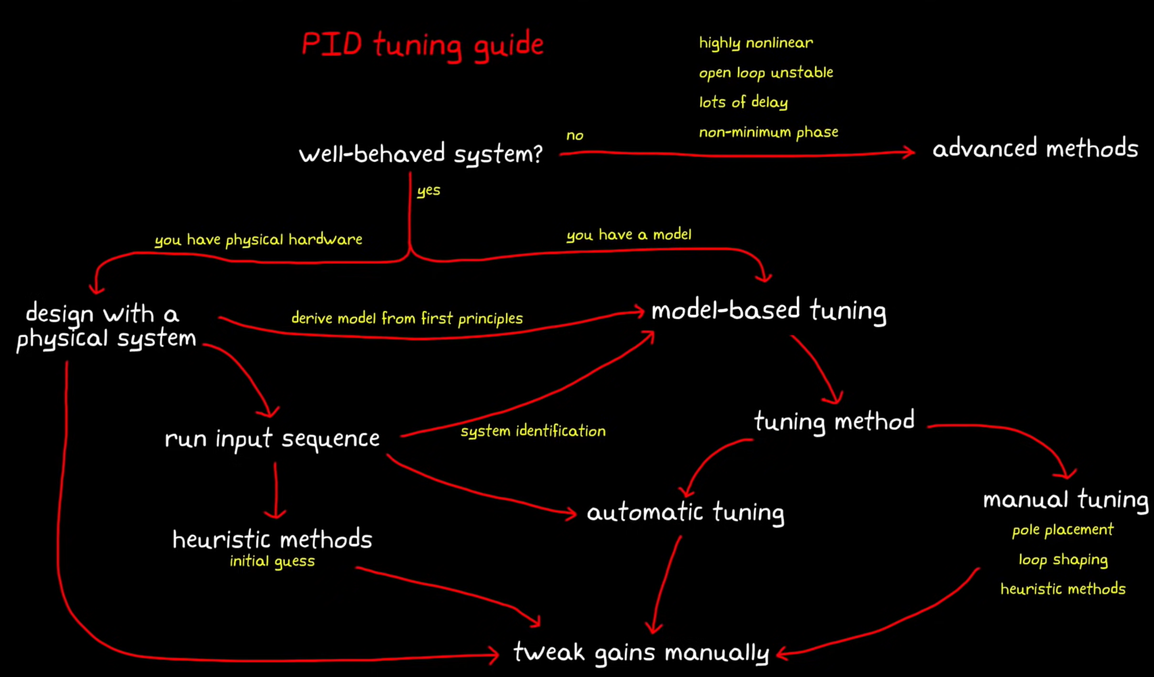
# PID TUNING

Slide 9
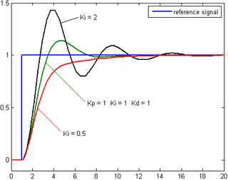
# STABILITY
# BODE PLOT
# NYQUIST PLOT
# NICHOLS PLOT
# POLE PLACEMENT

Slide 10
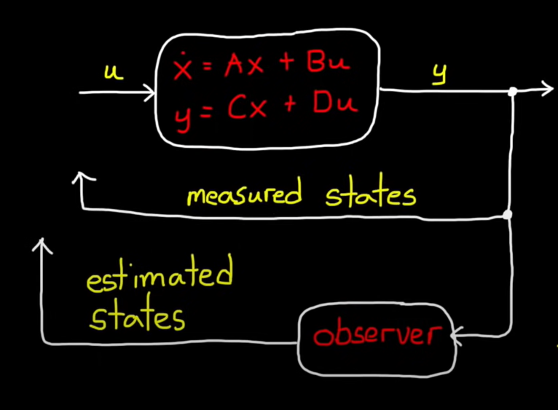
# CONTROLLER OBSERVER MODEL
10

Slide 11
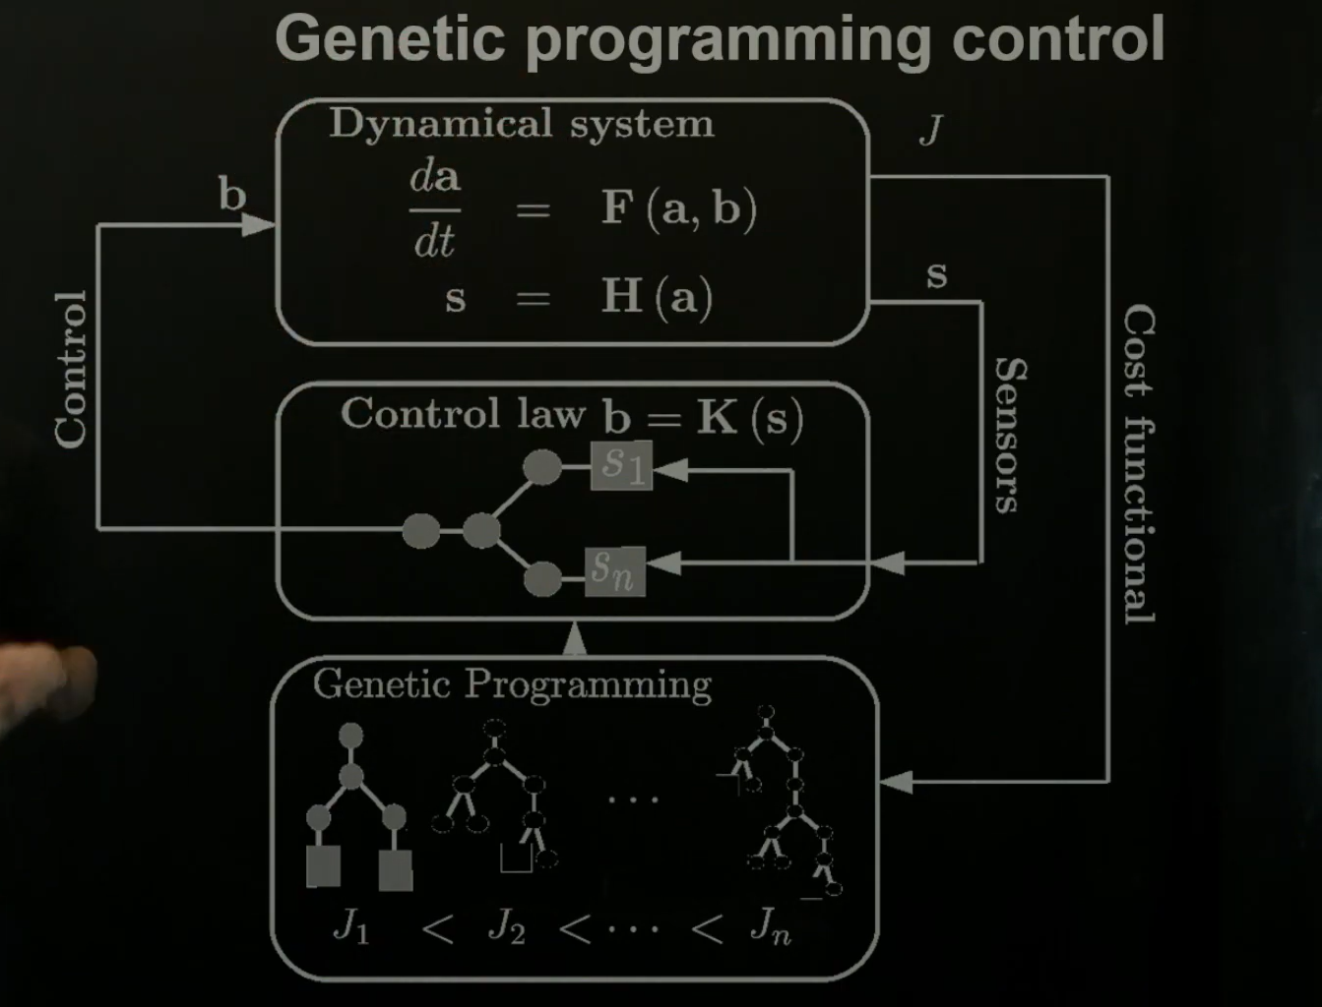
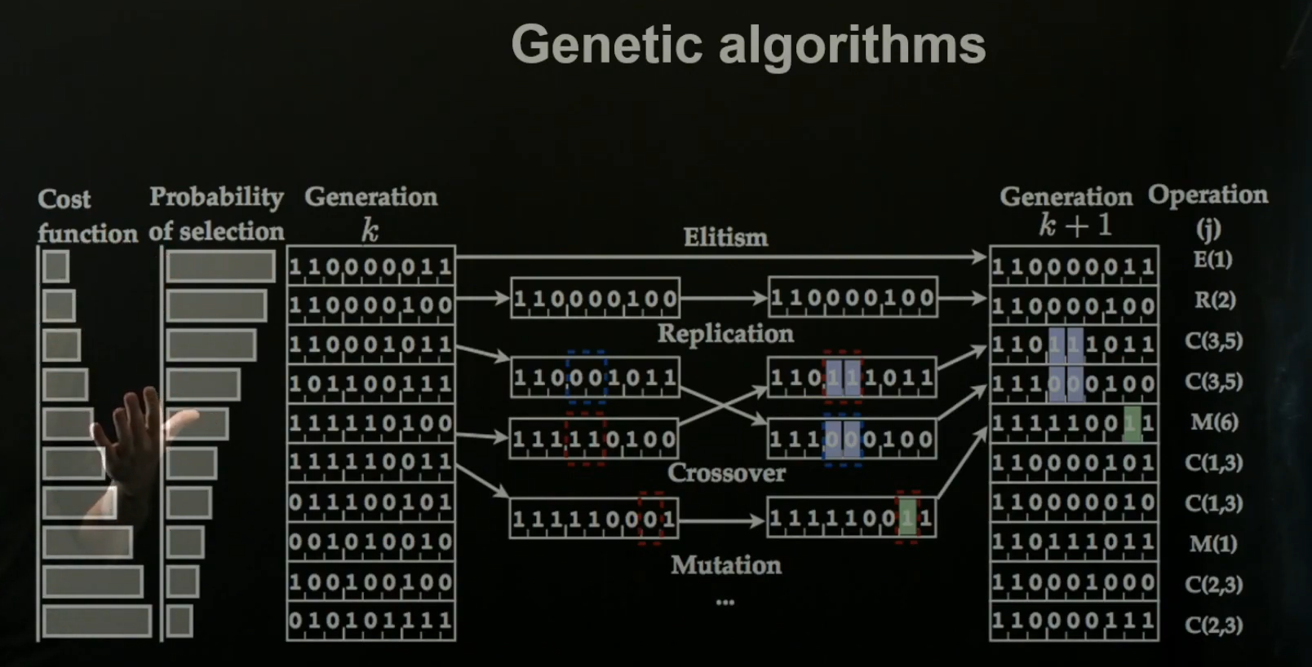
# CONTROL USING GENETIC ALGORITHM

Slide 12
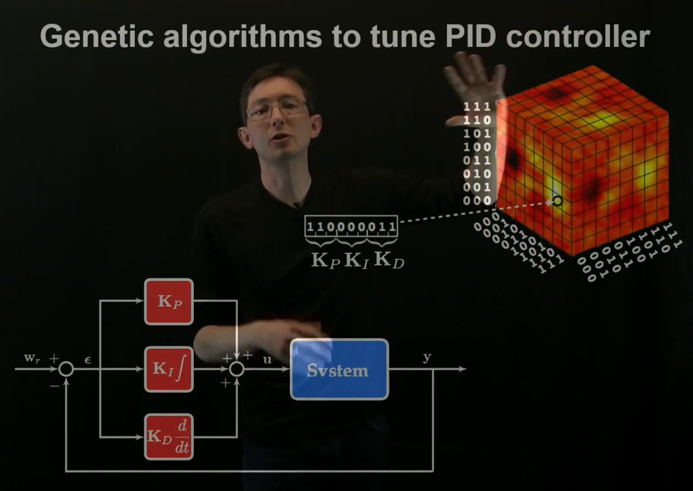
# PID TUNING USING GENETIC ALGORITHM

Slide 13
Danke! THANK YOU! धन्यवाद!
13

